Slide 1
Data Analysis of New York Traffic Tickets and Motor Vehicle Crashes.
Team members： Muhammad Bilal Jamil, Te Li, Mark Kaplan
Professor： Brandon Chiaza
Notes:
Jinming

Slide 2
Table of Contents:
Introduction
Project Strategy
Roles and Responsibilities
Summary of the datasets
Architecture diagram
AWS Services and OLTP
OLTP ERD
Problems to be solved
OLAP ERD
Tableau Dashboards
Challenges Faced?
Potential Use Cases
Conclusion & Reference

Slide 3
Introduction
New York has a developed economy and heavy traffic. New York has a lot of floating people and vehicles. It's not uncommon for drivers to get tickets. We downloaded New York's 2018 data from the DMV's official website. About 1.5 million people were fined. We will analyze this dataset. We want to get common code of violations, reasons for violations, violations by month, distribution of violations 7 days a week, what age group, which court, etc.
Our data management can visualize the ticket data in New York.
Do a comparison analysis with the data sources of tickets, motor vehicle crashes, violation codes and find the patterns.
Notes:
muhammad

Slide 4
Project strategy:
We will have 4 staging databases for each dataset, our project will have 4 data sources.
We will add in three more datasets for New York tickets, motor vehicle crashes.
We will deploy a data warehouse which will host data from all these 4 staging databases and this data warehouse will be used for our reporting purposes as well.
If any data from our source databases will be changed then the data warehouse will also be updated.
We will use Tableau for our reporting needs.
Notes:
mark

Slide 5
Roles and responsibilities
All datasets are from data.ny.gov,
Links shared previously
Platform:
AWS and python code （Te Li）
(Python code with unstructured data, S3 buckets, Glue, OLTP)
SQL Data Management（Muhammad）
(Architecture Diagram, data management, DDL, DML, Data warehouse and Tableau
Python code and Data profiling（Kaplan）
Notes:
mark

Slide 6
Potential Questions To Be Answered:
1. Violators who get tickets are mainly distributed from Monday to Friday, or Saturday and Sunday?
2. What are the common violations of tickets?
3. Which age group is more likely to get a ticket? Below 20, 20-30, 30-40, 40-50, 50-60
4. In which court are the fines mainly concentrated?
5. Men and women, which gender is more likely to get a ticket?
6. What is the pattern of the tickets, and the motor vehicle crashes?
7. What leads accidents, what are those patterns?
8. The common trends of the ticket and accident data. How can people avoid them?
9. What steps can we suggest for people to be more careful, aware about traffic situations, tickets and motor vehicle accidents which would have an impact on society directly.
Notes:
mark

Slide 7

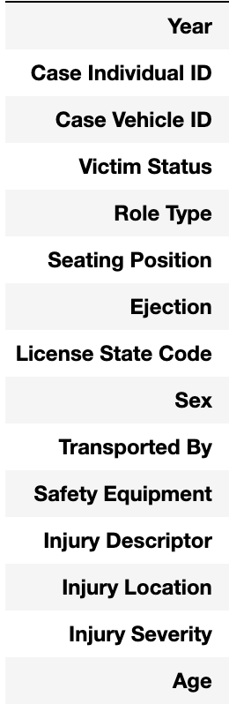
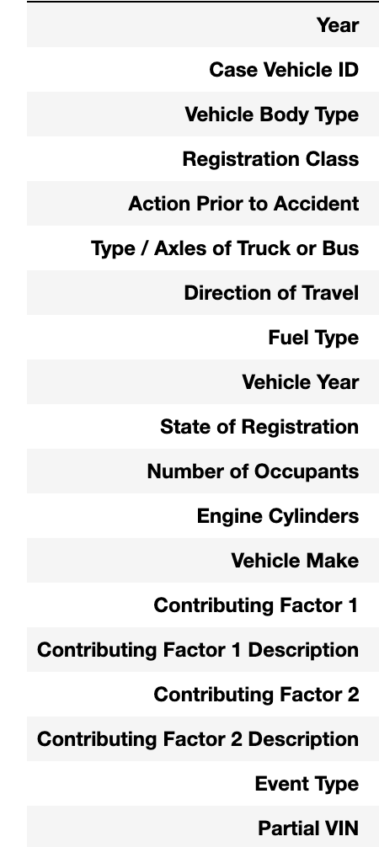
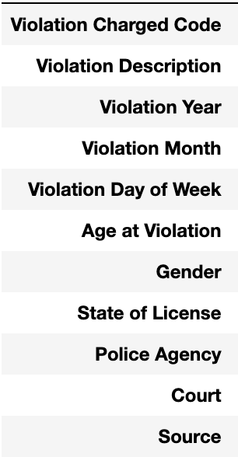
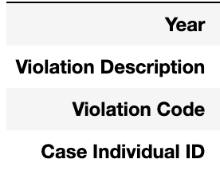
Summary of Dataset
Motor Vehicle Crashes - Individual Information: Three Year Window
Motor Vehicle Crashes - Vehicle Information: Three Year Window
Traffic Tickets Issued: Four Year Window
Motor Vehicle Crashes - Violation Information: Three Year Window
Notes:
mark

Slide 8
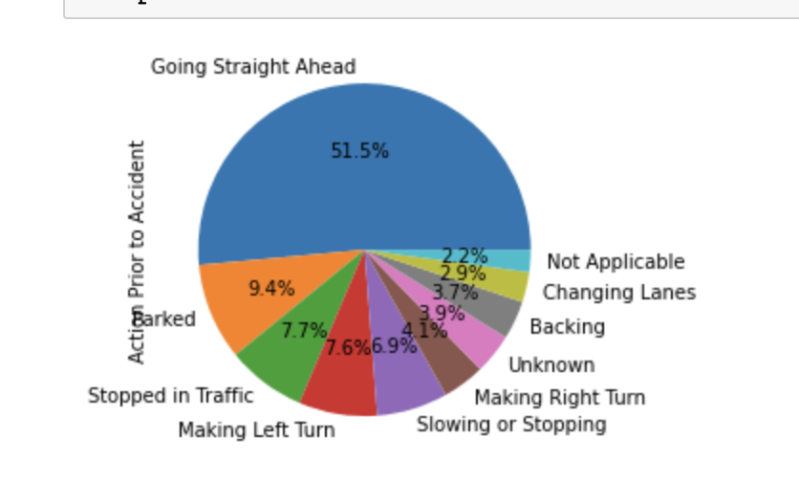
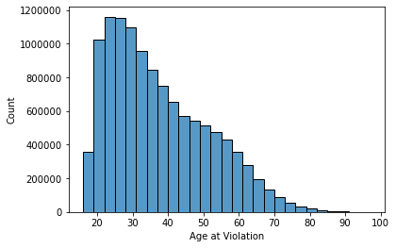
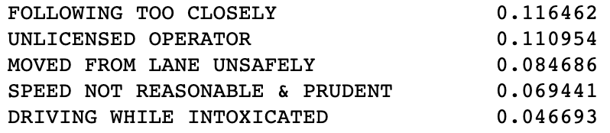
Summary of Dataset
Motor Vehicle Crashes - Individual Information: Three Year Window
Motor Vehicle Crashes - Vehicle Information: Three Year Window
Traffic Tickets Issued: Four Year Window
Motor Vehicle Crashes - Violation Information: Three Year Window
Notes:
mark

Slide 9
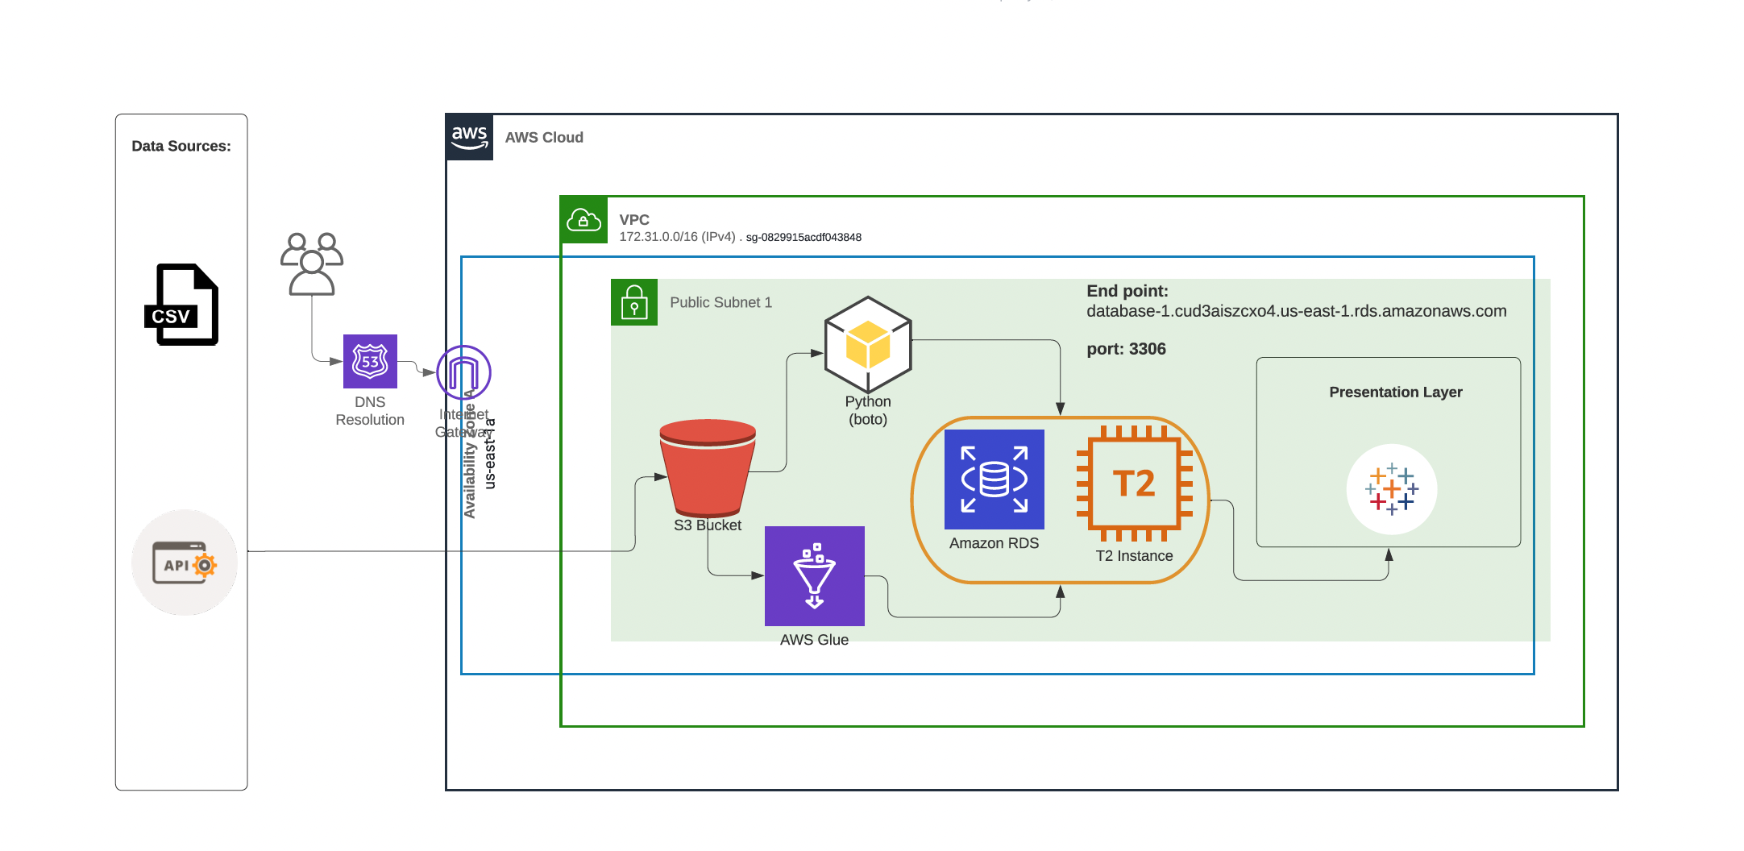
Architecture Diagram
Notes:
muhammad

Slide 10
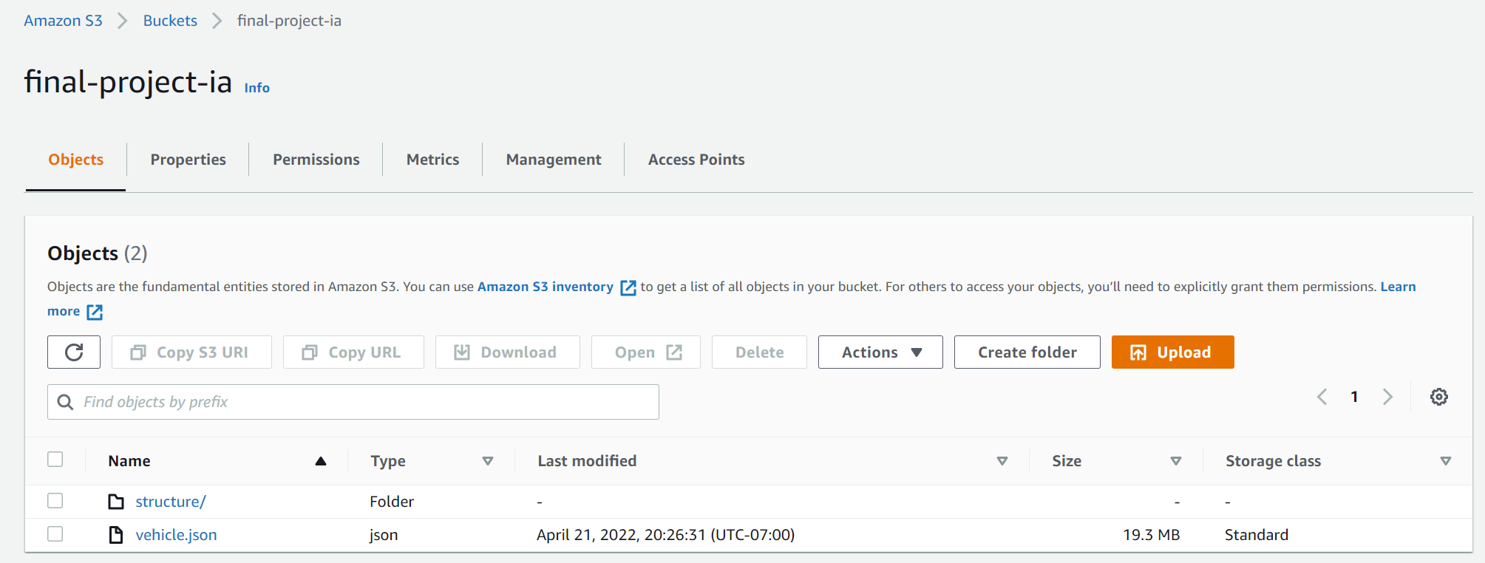
Amazon Web Services
Download 3 structure data and 1 unstructured data from dmv government website
S3 Data:
Vehicle.json unstructure data
Notes:
te

Slide 11
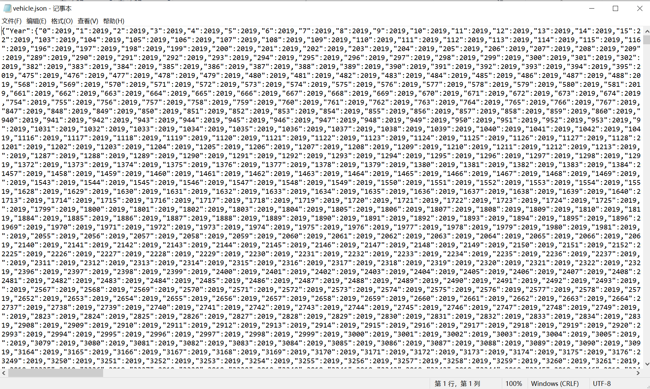
Amazon Web Services
Unstructured data is irregular and very messy
S3 Data:
Vehicle.json unstructure data
Notes:
te

Slide 12
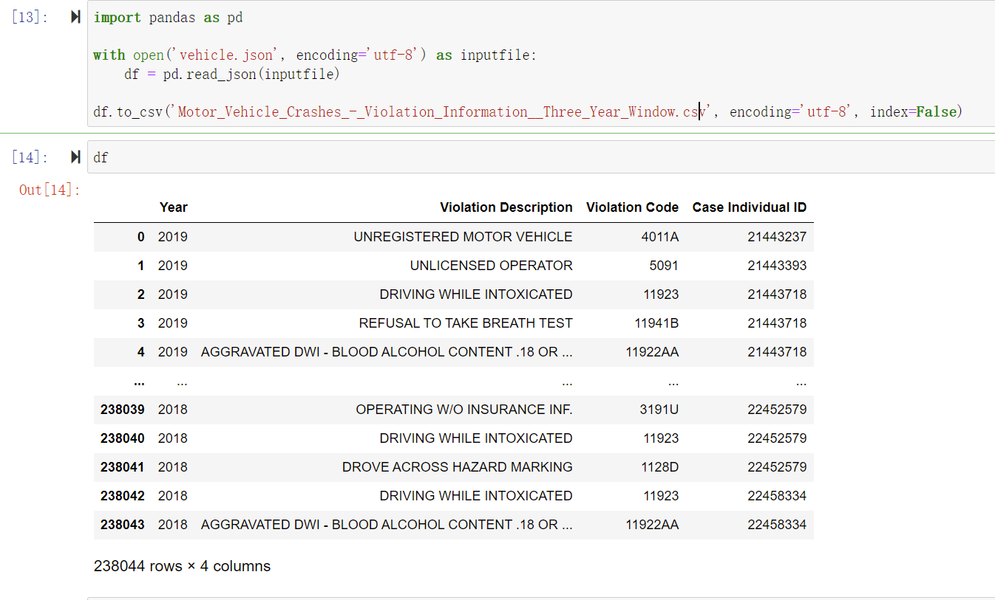
Amazon Web Services
Unstructured data to structured data
Notes:
te

Slide 13
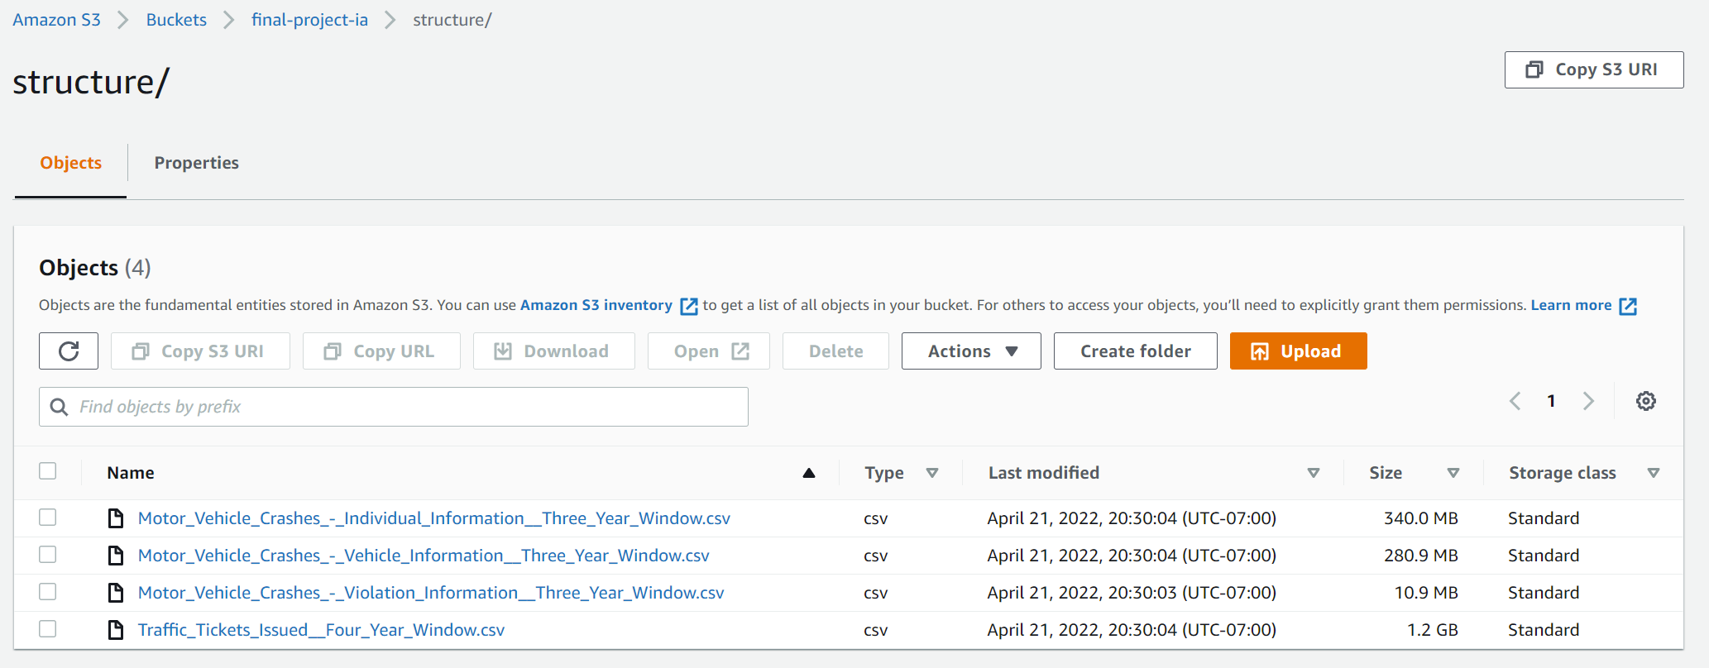
Amazon Web Services
Structure data
Notes:
te

Slide 14
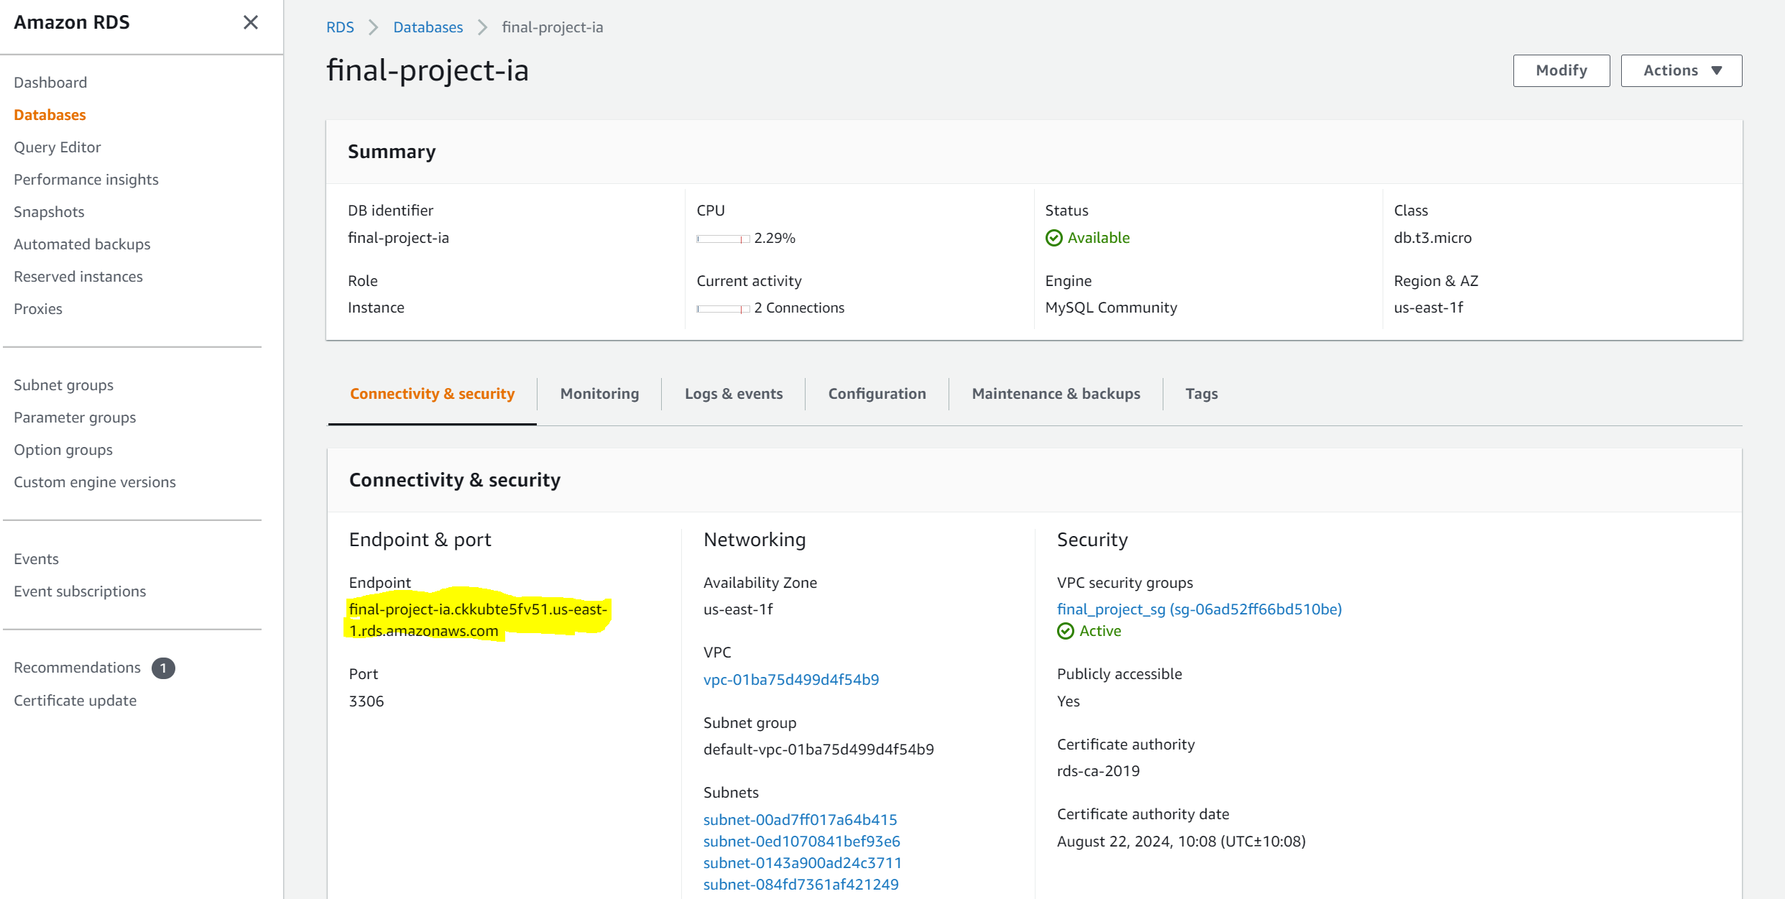
Amazon Web Services
RDS:
Endpoint: connect sql workbench
Endpoint: final-project-ia.ckkubte5fv51.us-east-1.rds.amazonaws.com
Username: admin
Password: 12345678
Notes:
te

Slide 15
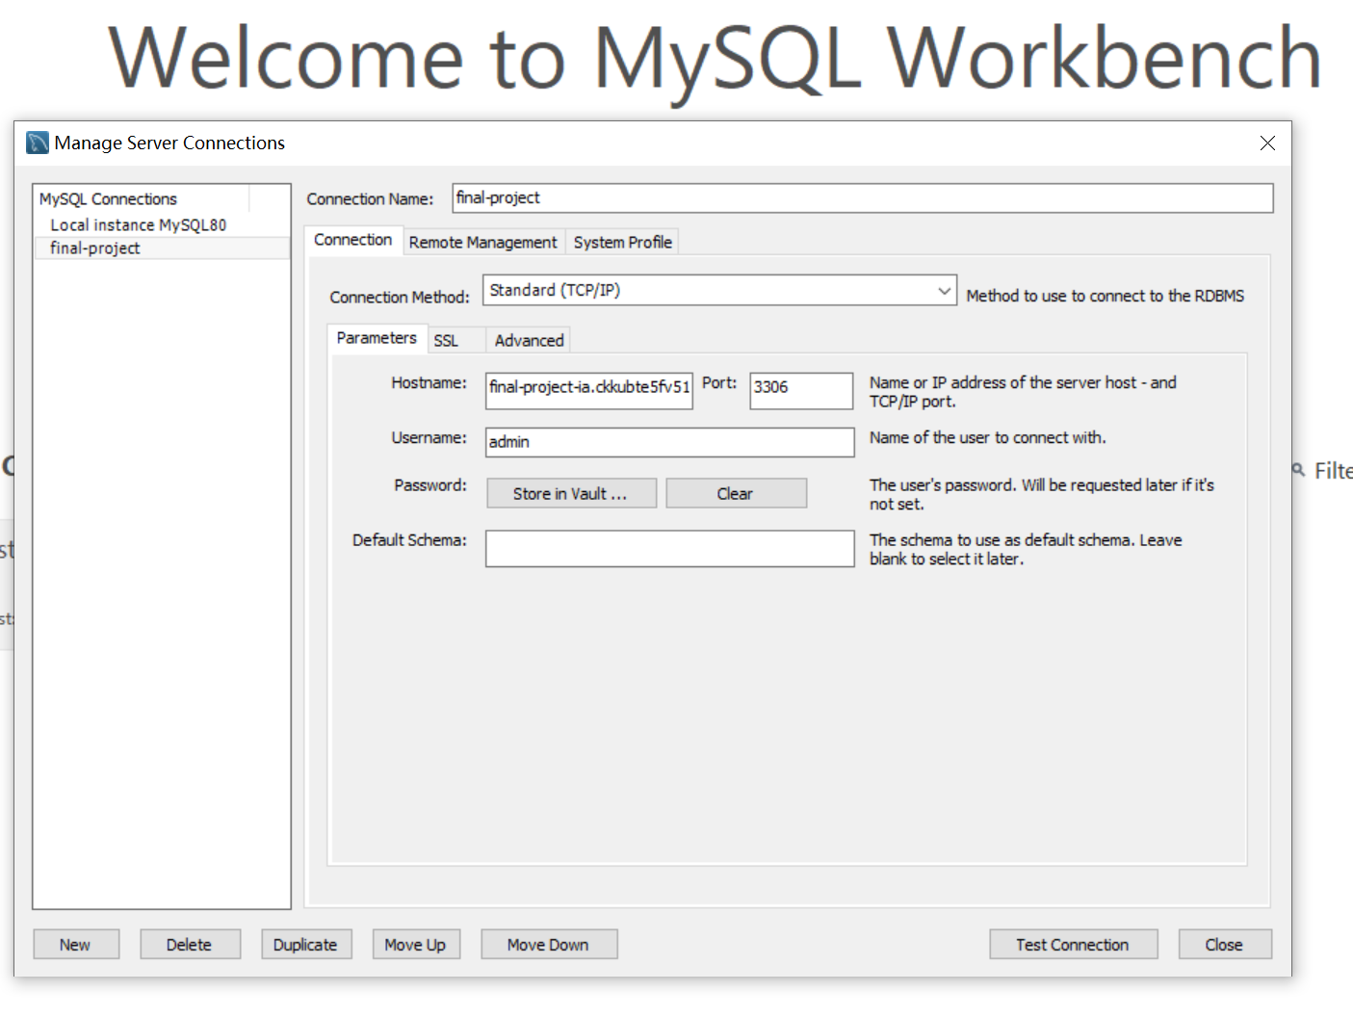
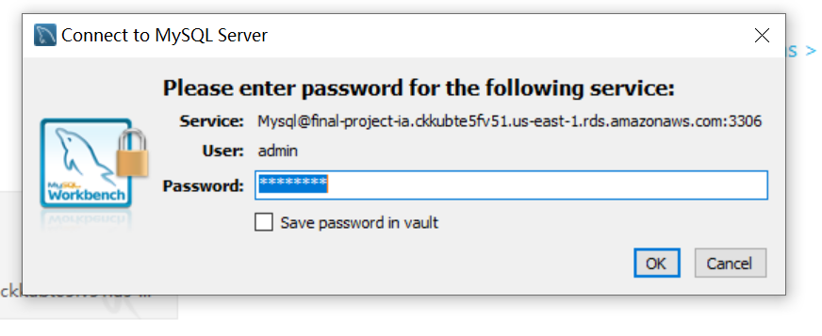
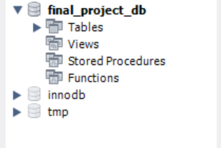
Amazon Web Services
SQL Work Bench:
The dataset is named final_project_db which
is empty
Notes:
te

Slide 16
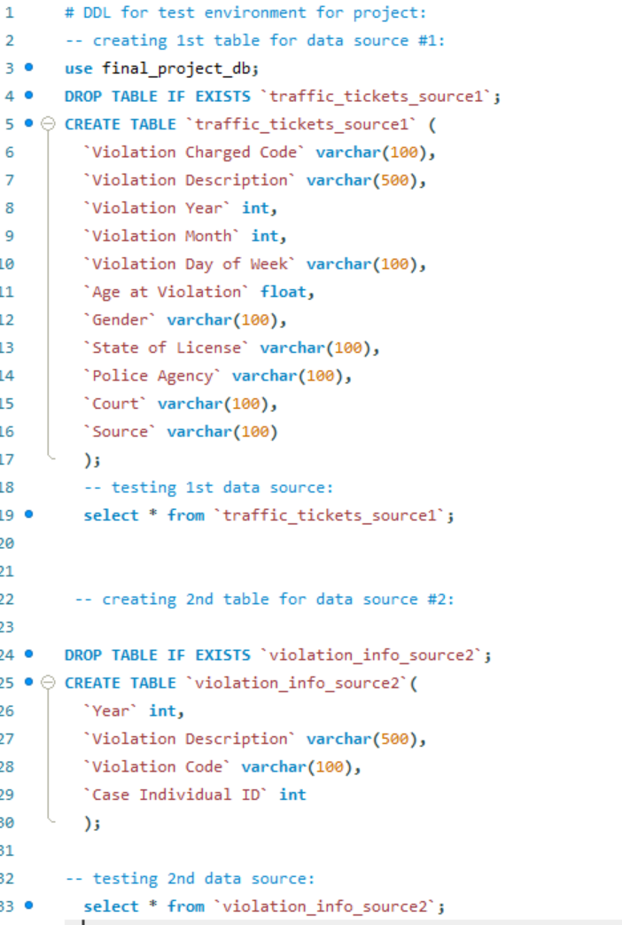
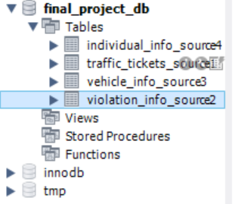
Amazon Web Services
I created a ddl to create 4 empty tables as below
After running the sql ddl, there’re 4 empty tables under the
dataset schema.
Notes:
te

Slide 17
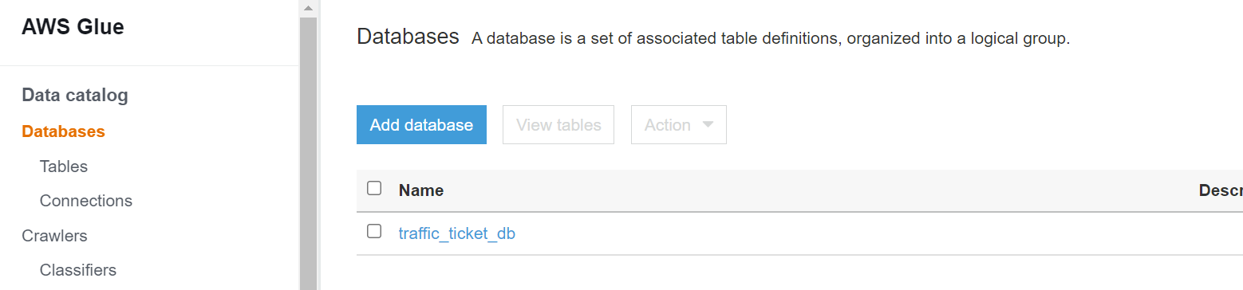
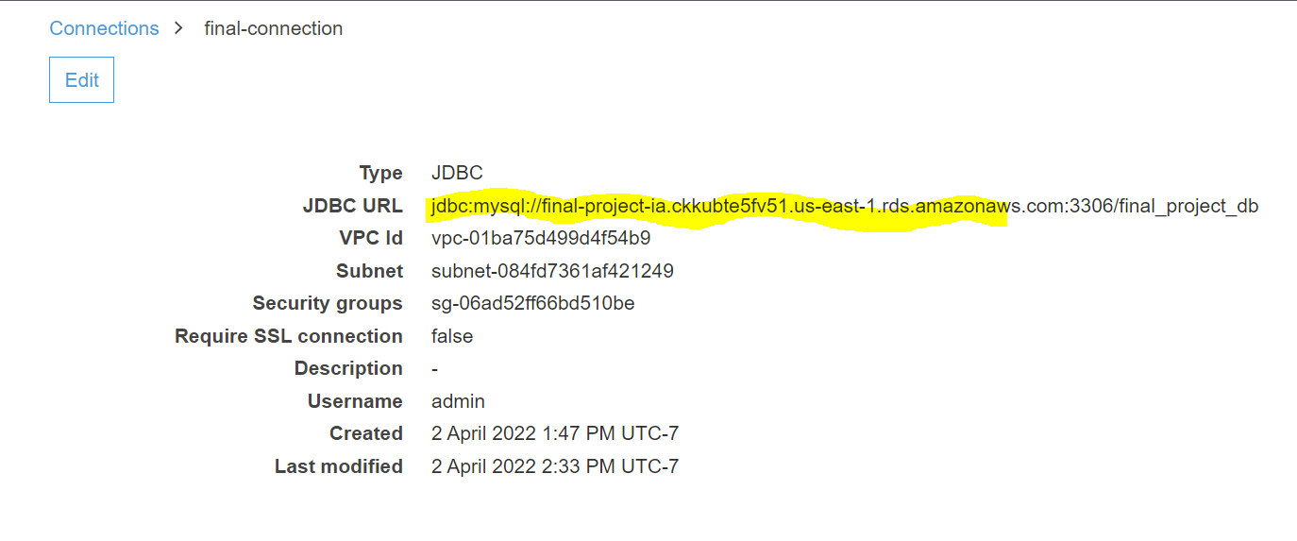
Amazon Web Services
Glue:
Create Database
Create Connection to SQL
Notes:
te

Slide 18
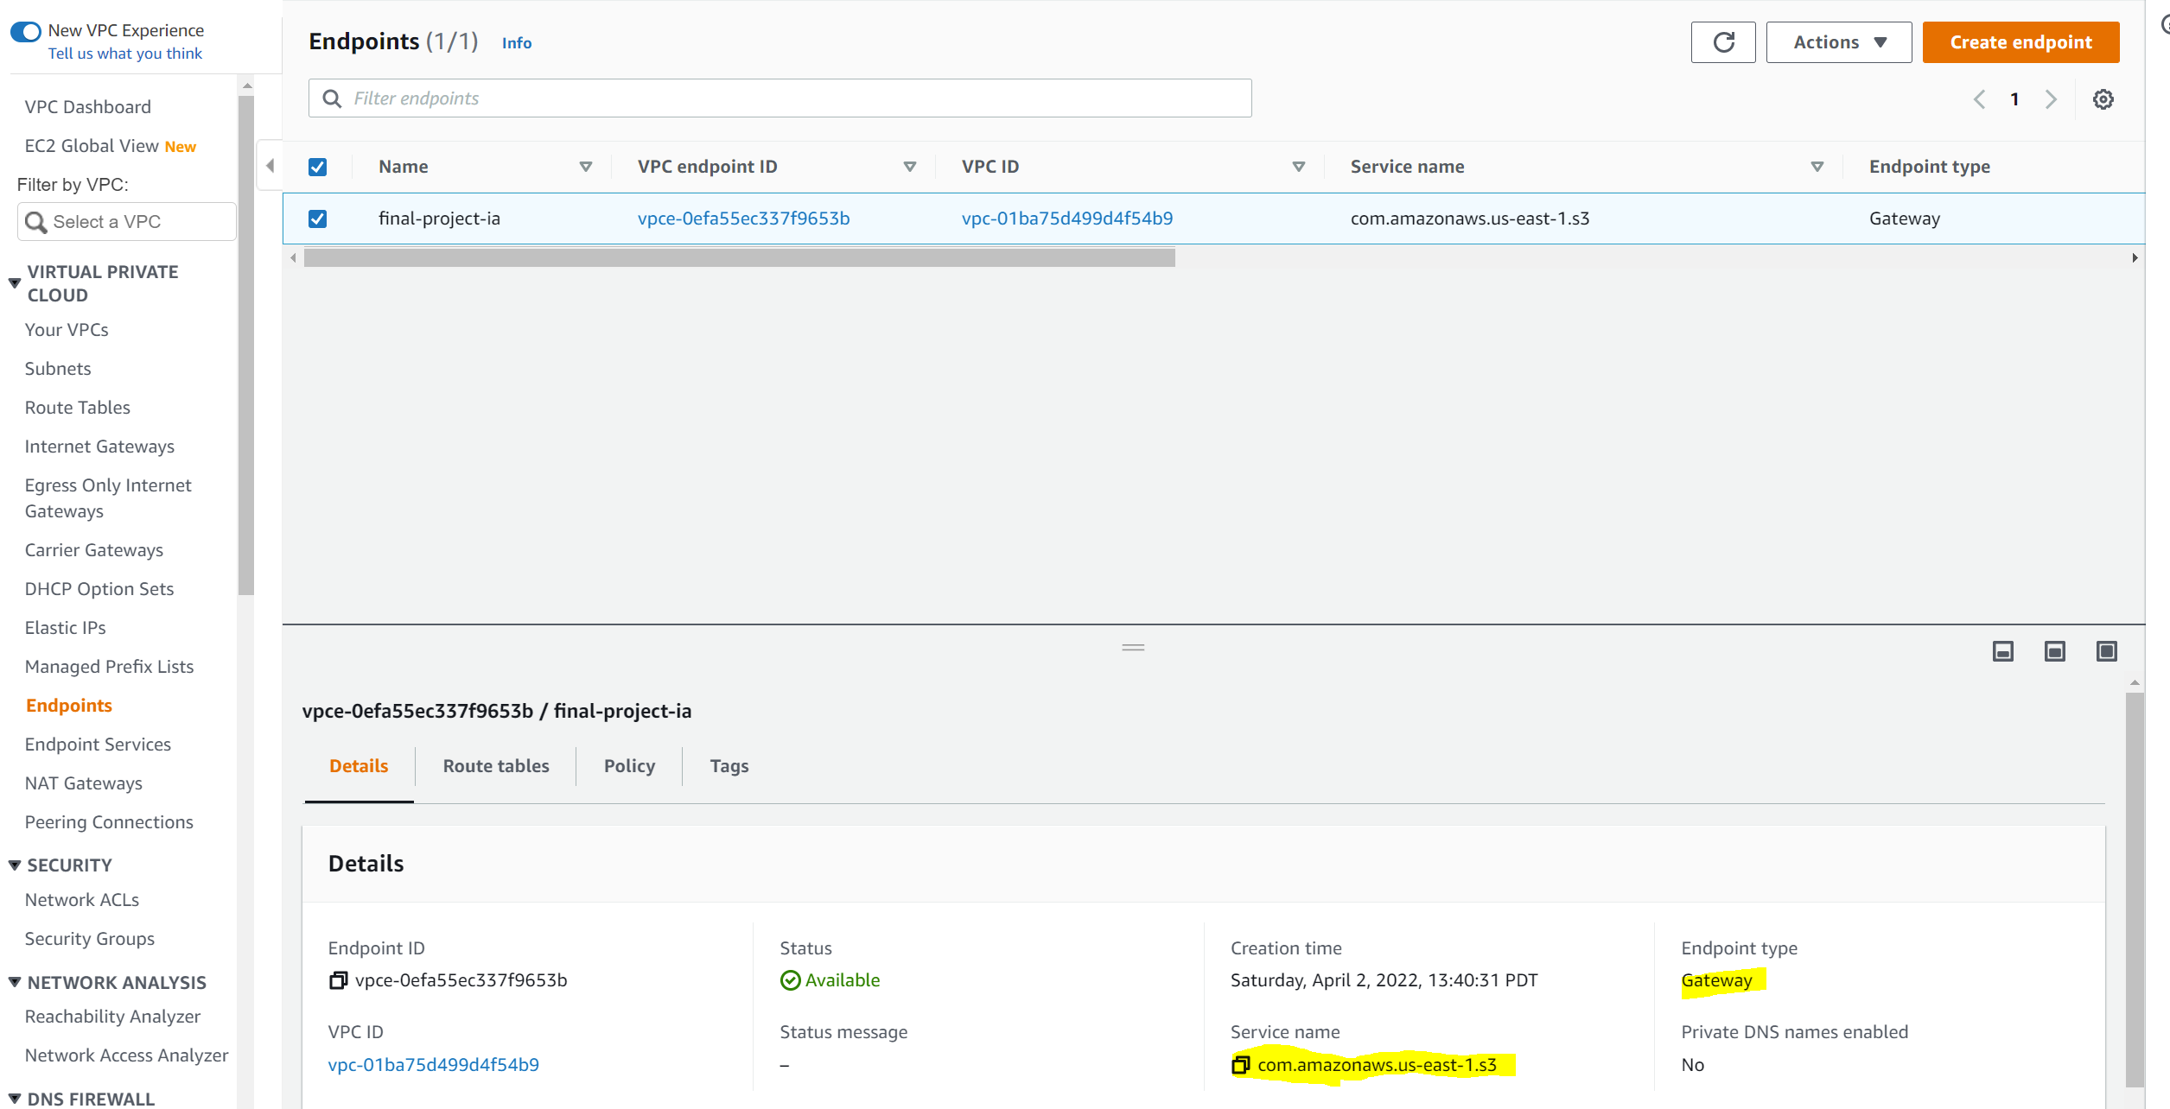
Amazon Web Services
Configuration: VPC service. create endpoint with gateway to connect S3 service, so Glue can do the crawler from s3.
Notes:
te

Slide 19
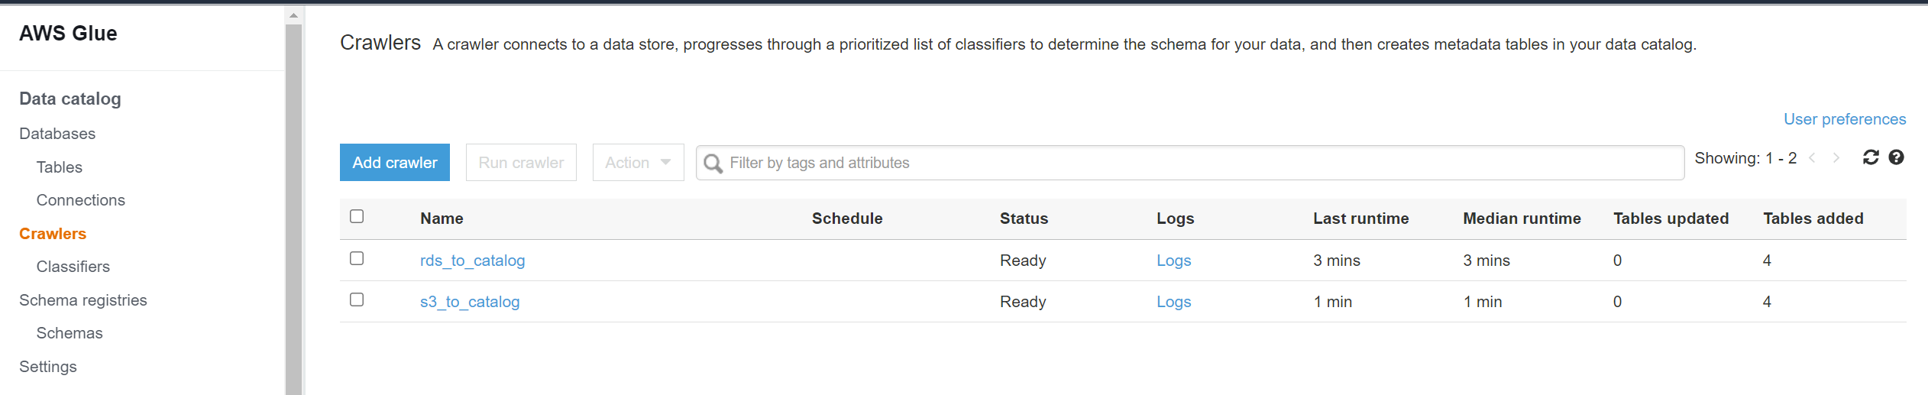
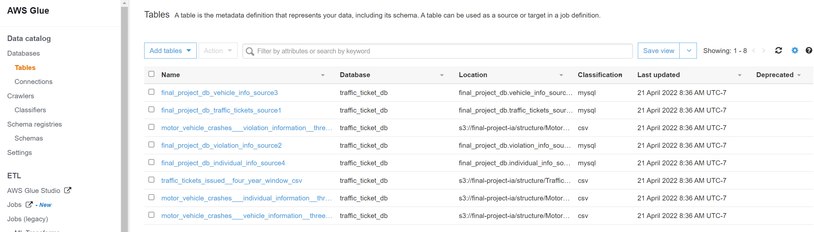
Amazon Web Services
Use the Glue Crawler to copy the tables from sql workbench to Glue data catalog
Use the Glue Crawler to copy the tables from S3 bucket/structure/ to Glue data catalog
Data Catalog tables (4 from sql, 4 from s3 bucket, totally 8 tables):
Notes:
te

Slide 20
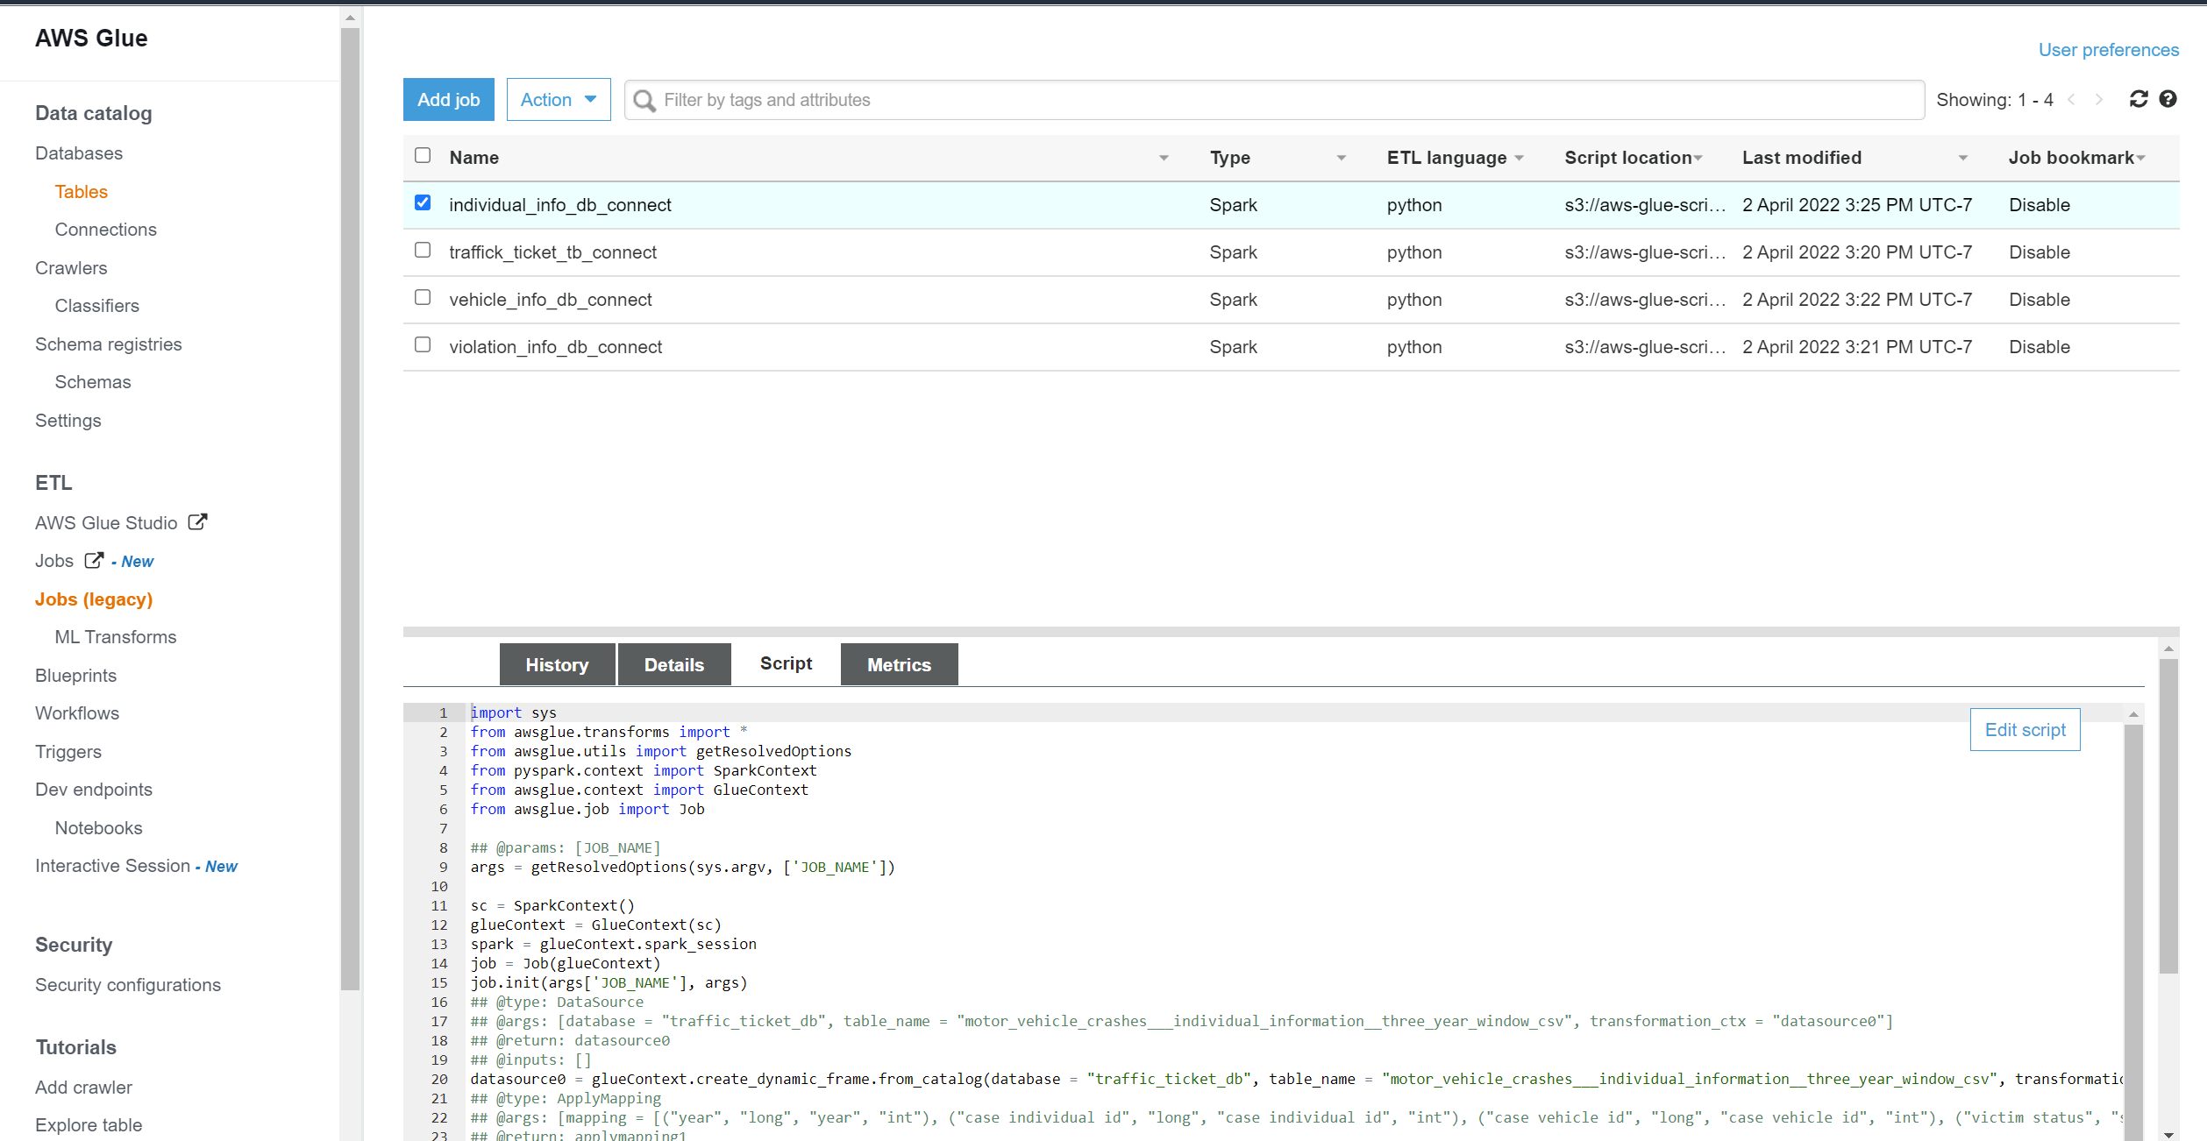
Amazon Web Services
Create Glue jobs: script is automatically generated from connection
Notes:
te

Slide 21
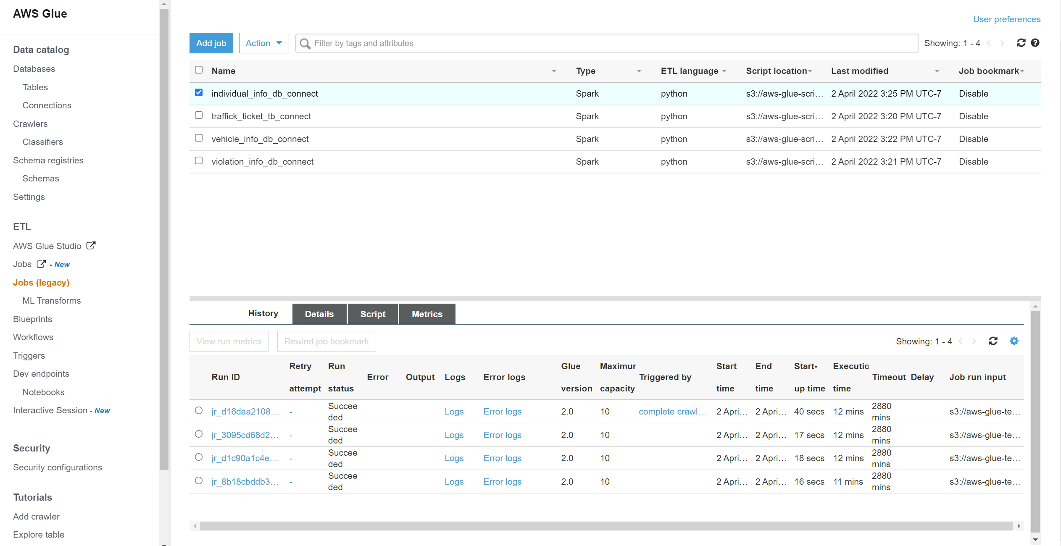
Amazon Web Services
After running all jobs, it’s successful
Notes:
te

Slide 22
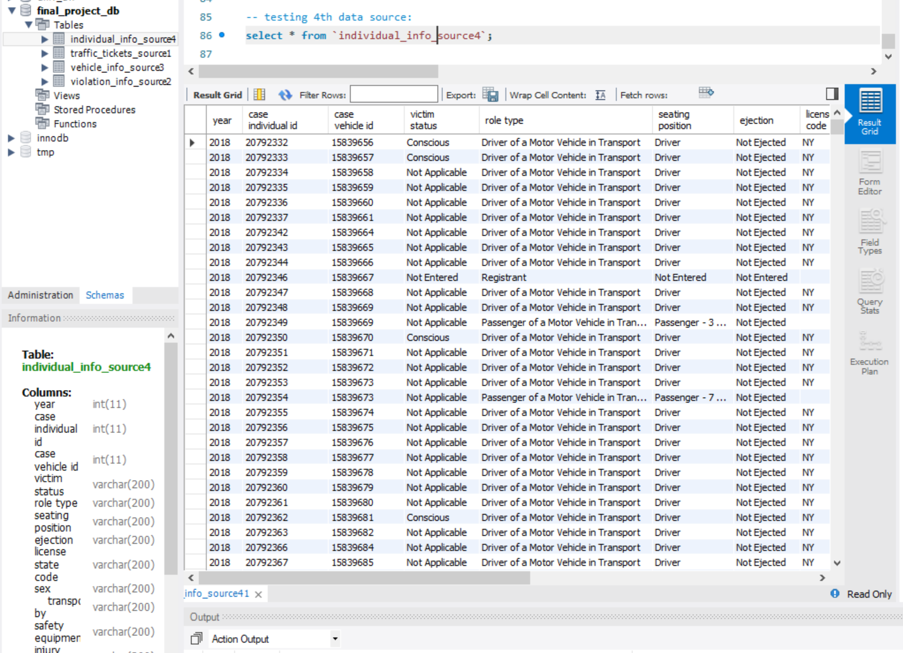
Amazon Web Services
All tables from s3 are copied to sql tables. This is the result of one of the tables
Notes:
te

Slide 23
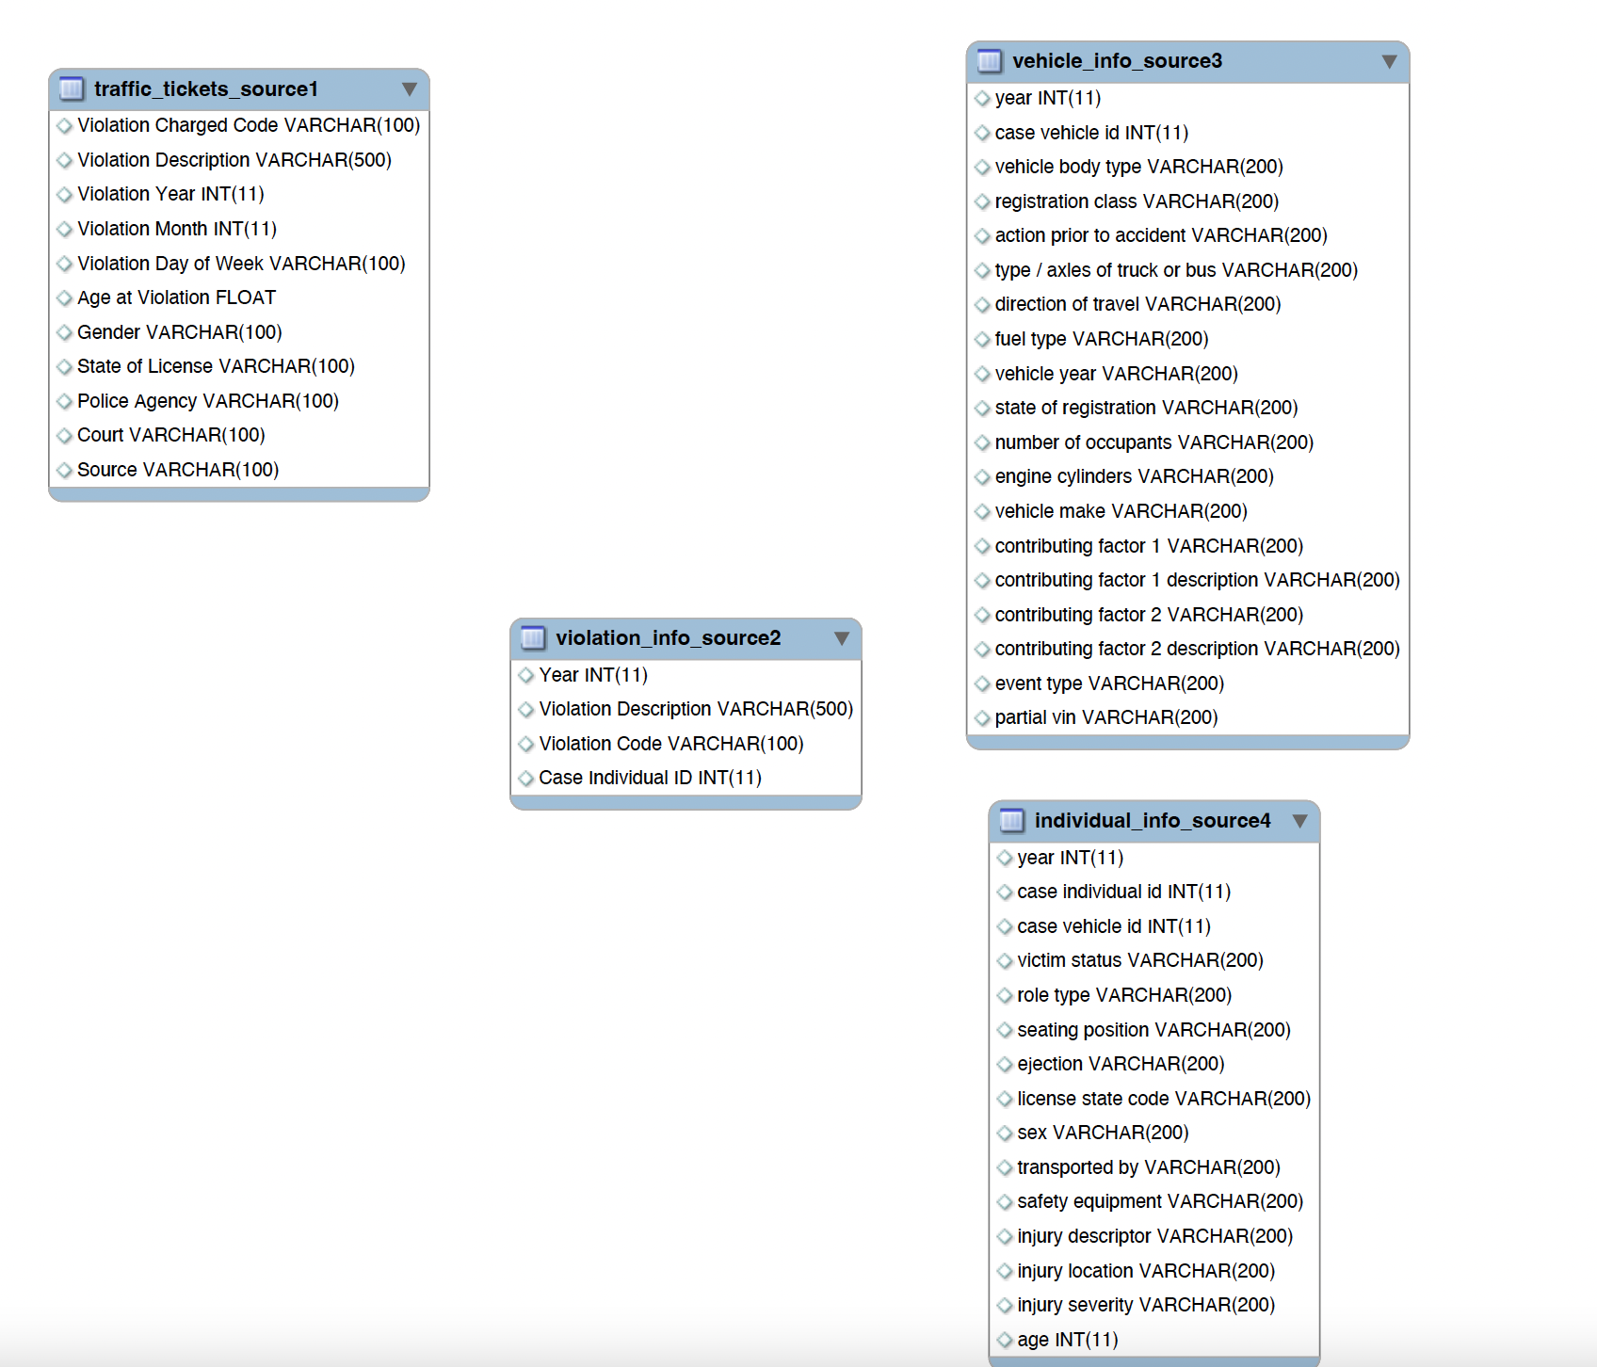
OLTP ERD
Notes:
muhammad

Slide 24
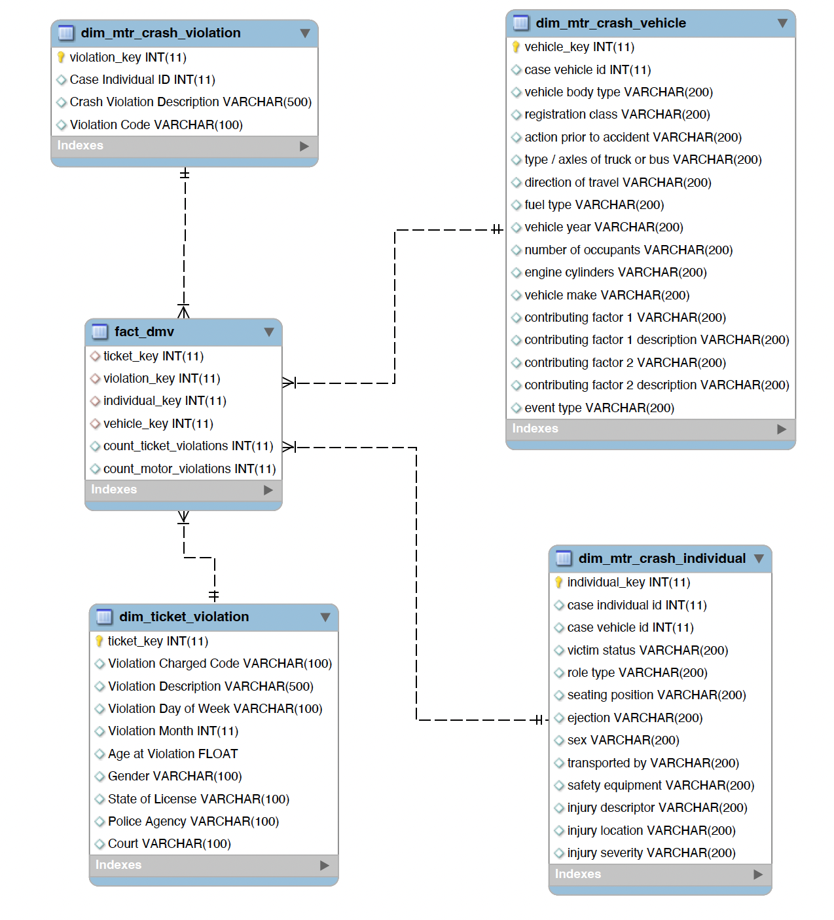
OLAP ERD
Notes:
muhammad

Slide 25
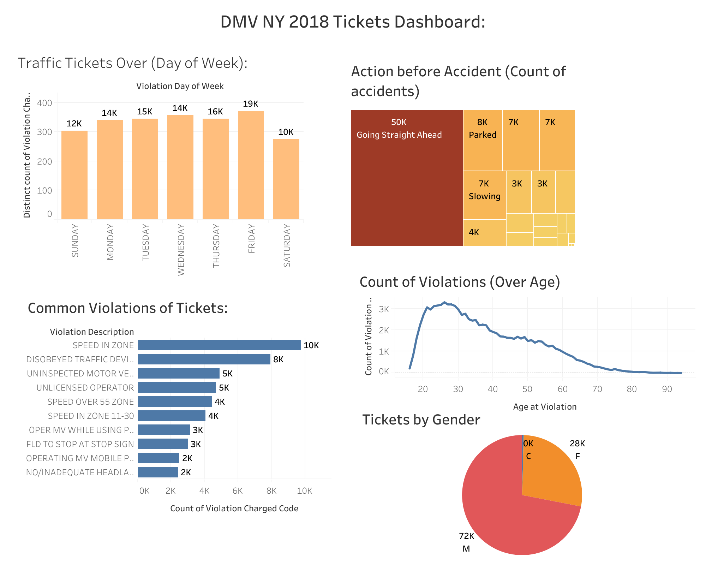
Tableau Dashboard #1 (Tickets data vs crash data)
Notes:
muhammad

Slide 26
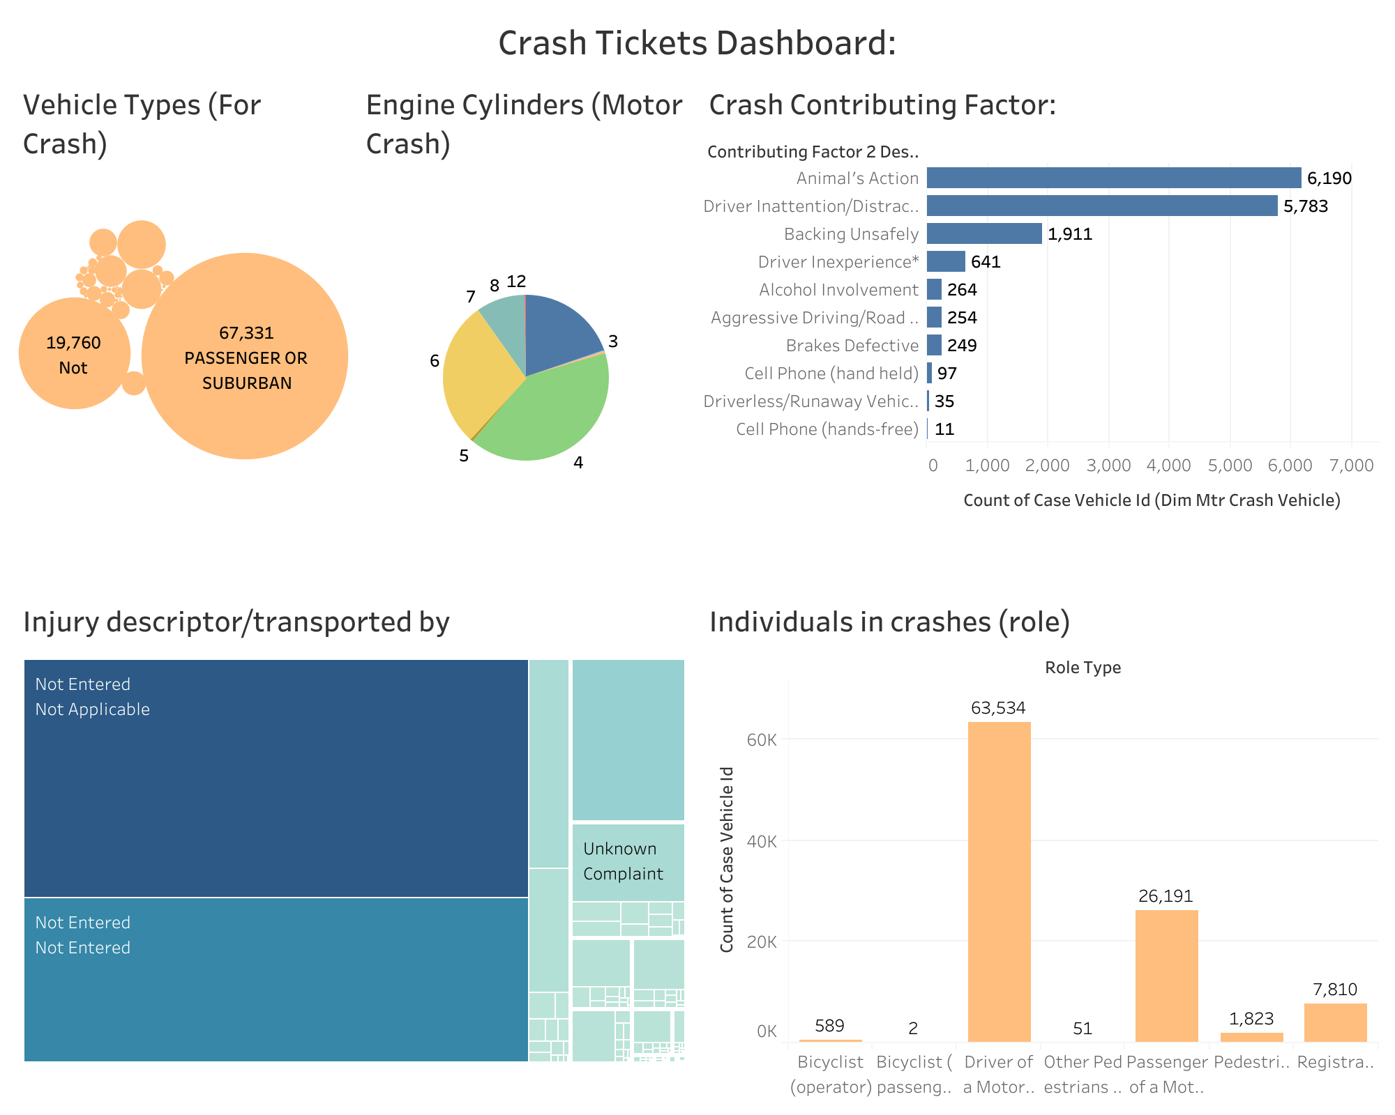
Tableau Dashboard 2 (crash tickets with individual stats)
Notes:
muhammad

Slide 27
Problems Faced:
There is a lot of descriptors which are not ‘entered’ during the ticket creation process which would eventually if would be present could help with better data analysis.
Successfully loading data in OLTP due to big size of data.
ETL delay issues in data warehouse, learned on how to make optimized ETL workflows.
For higher level of data, better to have indexes and partition the tables which will improve the efficiency.
Notes:
mark

Slide 28
Potential Use Cases/User Profiles
Government Safety Officials
Automobile Manufacturers
Automobile Insurance Companies
Police Officials
Notes:
mark

Slide 29
Conclusion
1. People are more likely to get tickets Monday through Friday, and fewer Saturdays and Sundays.
2. Common tickets include speeding, stop sign, violation of traffic signs, running red lights, not wearing seat belts.
3. Drivers from the age of 20-30 are easy to get a ticket, and 50-60 years old are also easy to get a ticket. Other age groups get less fines.
4. The main reason of motor vehicle crashes from our analysis is that its because of animal action the most, followed by driver not being attentive and backing irresponsibly.
5. There are fewer fines in December-February, and more in other months
6. The courts where the fines are mainly concentrated are: MANHATTAN SOUTH TVB, QUEENS NORTH TVB, BROOKLYN SOUTH TVB
7. We also noticed that a lot of data goes missing in the traffic tickets as well as motor vehicle crashes tickets, which gives the interpretation that better data quality checks and standardization should be there.
Notes:
muhammad

Slide 30
Reference
https://data.ny.gov/Transportation/Traffic-Tickets-Issued-Four-Year-Window/q4hy-kbtf
https://data.ny.gov/Transportation/Motor-Vehicle-Crashes-Violation-Information-Three-/abfj-y7uq
https://data.ny.gov/Transportation/Motor-Vehicle-Crashes-Individual-Information-Three/ir4y-sesj
https://data.ny.gov/Transportation/Motor-Vehicle-Crashes-Vehicle-Information-Three-Ye/xe9x-a24f

Slide 31
Thank you Any questions?

